Slide 1
Generic Sensitivity: Customizing Context-Sensitive Pointer Analysis for Generics
Haofeng Li, Jie Lu, Haining Meng, Liqing Cao,
Yongheng Huang, Lian Li* and Lin Gao

Slide 2


Pointer Analysis
$$P$$
→
$$O$$
pointer
variable
abstract
location

Slide 3




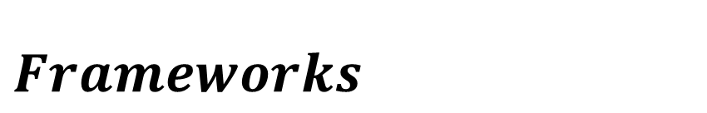
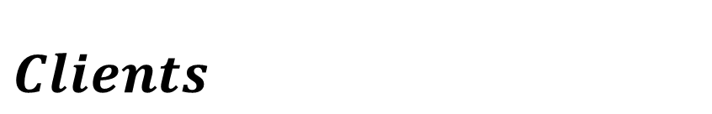
Pointer Analysis
$$Clients$$
$$Frameworks$$
Callgraph
Bug detection
Compiler optimization
Security analysis
Taint analysis
...
...

Slide 4
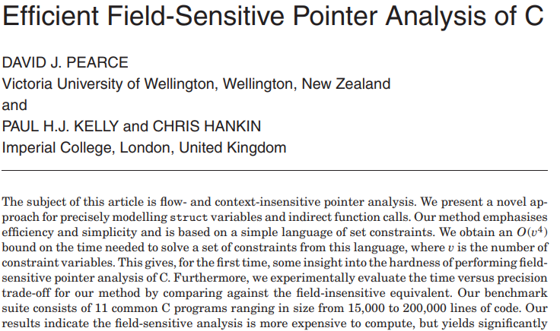
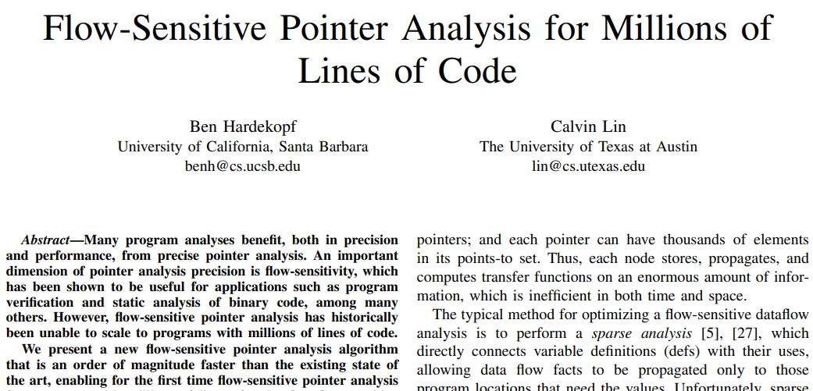
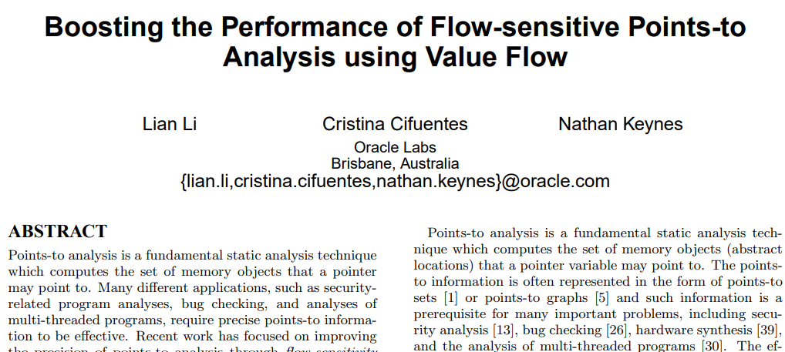
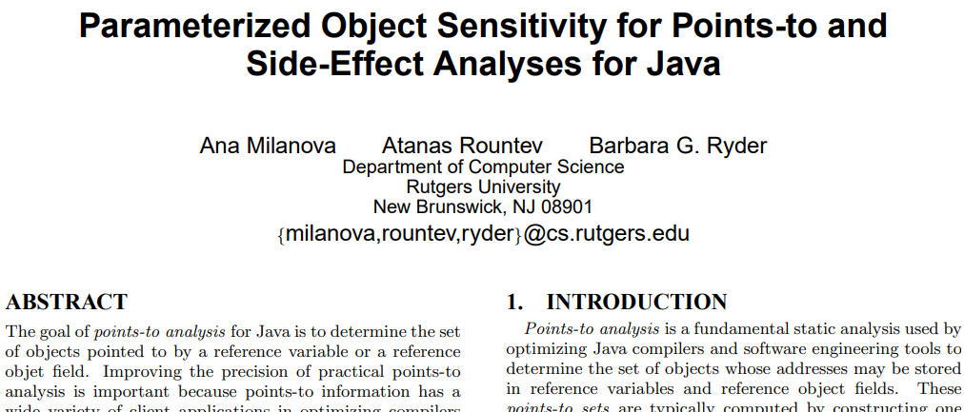
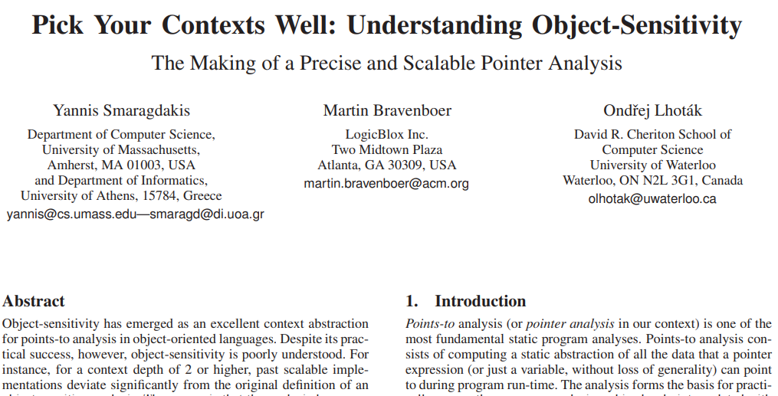
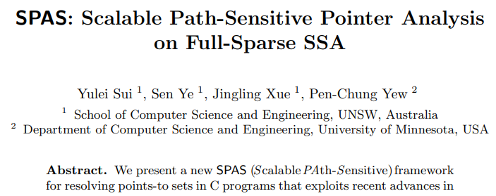
Sensitivity
Field sensitivity
Flow sensitivity
Context sensitivity
Path sensitivity

Slide 5
Sensitivity
Field sensitivity
Flow sensitivity
Context sensitivity
Path sensitivity

Slide 6
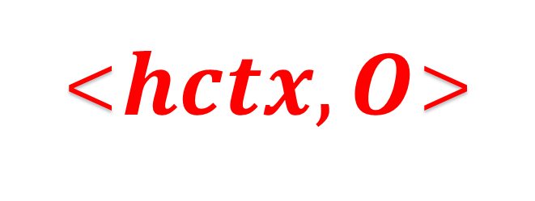
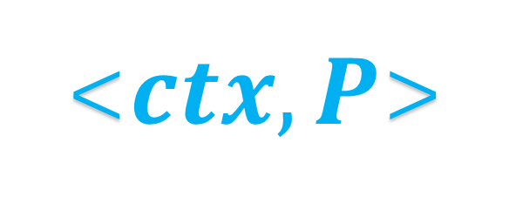
Context sensitivity
<$ctx, P$>
→
<$hctx, O$>
context
pointer
variable
heap
context
abstract
location

Slide 7
Mainstream variants of context-sensitivity
K-limiting
[C_{k},…,C₁]
Call-Site Sensitivity
Object Sensitivity
Type Sensitivity
1 main() {
2 A a = new A();//O
3 a.foo();
4 }
5 class A {
6 void foo(){}
7 }

Slide 8
Mainstream variants of context-sensitivity
K-limiting
[C_{k},…,C₁]
Call-Site Sensitivity
Object Sensitivity
Type Sensitivity
: C₁ = L₃
: C₁ = O
: C₁ = A
1 main() {
2 A a = new A();//O
3 a.foo();
4 }
5 class A {
6 void foo(){}
7 }

Slide 9
Mainstream variants of context-sensitivity
K-limiting
[C_{k},…,C₁]
Call-Site Sensitivity
Object Sensitivity
Type Sensitivity
: C₁ = L₃
: C₁ = O
: C₁ = A
1 main() {
2 A a = new A();//O
3 a.foo();
4 }
5 class A {
6 void foo(){}
7 }
_{√OO Programs}

Slide 10
Challenge
K
precision
4
efficiency
3
Unscalable
2
1

Slide 11
More effective representation
of the context ？
We propose a new context
customization scheme for generics.

Slide 12
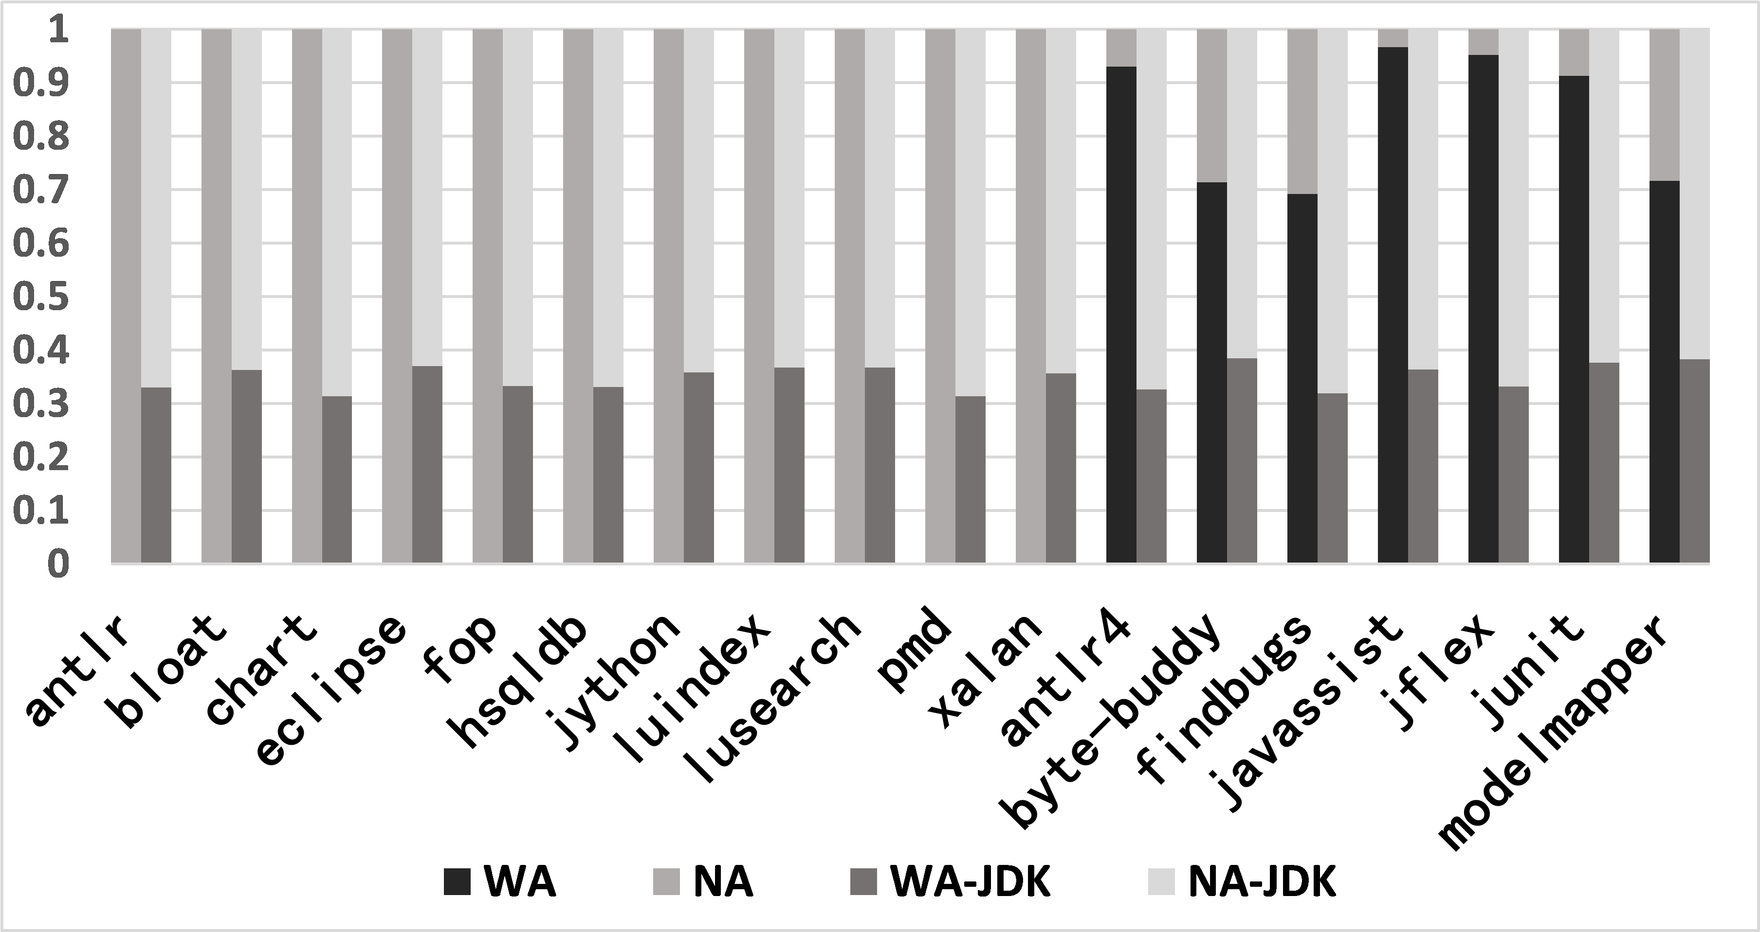
Percentages of generic object allocations with actual types. WA is with actual types, NA is without actual types, WA-JDK and NA-JDK are generic object allocations in JDK with or without actual types.

Slide 13
Instantiate sites of generics
21
345
antlr
antlr4
2005
2021

Slide 14
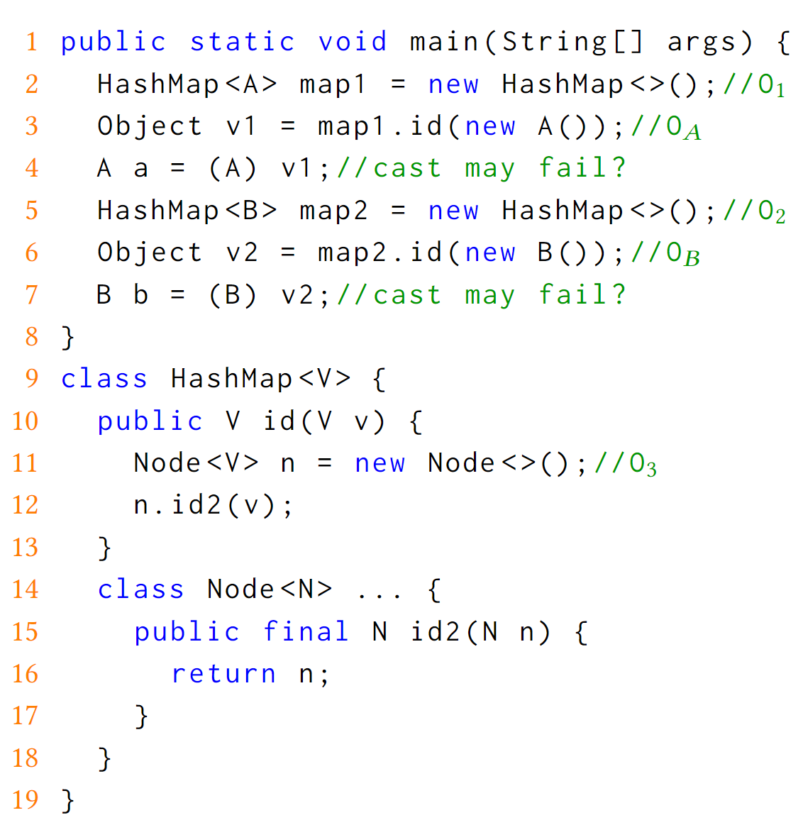

Code example

Slide 15
Code example

Slide 16
Code example

Slide 17
Code example

Slide 18
Code example

Slide 19
Object sensitivity

Slide 20
Object sensitivity
$ctx$: O1
$ctx$: O2

Slide 21
Object sensitivity
$ctx$: O1
$ctx$: O2
< O1, v> → {OA}
< O2, v> → {OB}

Slide 22
Object sensitivity
$ctx$: O1
$ctx$: O2
< O1, v> → {OA}
< O2, v> → {OB}
$ctx$: O3
< O3, n> → {OA,OB}

Slide 23
Object sensitivity
$ctx$: O1
FAIL
$ctx$: O2
FAIL
< O1, v> → {OA}
< O2, v> → {OB}
$ctx$: O3
< O3, n> → {OA,OB}

Slide 24
Object sensitivity
$ctx$: O1
FAIL
$ctx$: O2
FAIL
< O1, v> → {OA}
< O2, v> → {OB}
$ctx$: O3
< O3, n> → {OA,OB}
< [O1, O3], n> → {OA}
< [O2, O3], n> → {OB}

Slide 25
Object sensitivity
√
$ctx$: O1
√
$ctx$: O2
< O1, v> → {OA}
< O2, v> → {OB}
$ctx$: O3
< O3, n> → {OA,OB}
< [O1, O3], n> → {OA}
< [O2, O3], n> → {OB}

Slide 26
Object sensitivity with generic customization

Slide 27
Object sensitivity with generic customization
$ctx$: V → O1
$ctx$: V → O2

Slide 28
Object sensitivity with generic customization
$ctx$: V → O1
$ctx$: V → O2
< V→O1, v> → {OA}
< V→O2, v> → {OB}

Slide 29
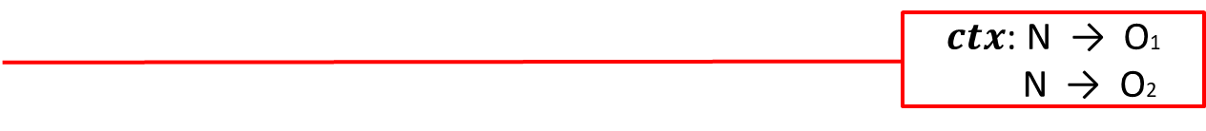
Object sensitivity with generic customization
$ctx$: V → O1
$ctx$: V → O2
< V→O1, v> → {OA}
< V→O2, v> → {OB}
$ctx$: N → O1
N → O2
< N→O1, n> → {OA}
< N→O2, n> → {OB}

Slide 30
Object sensitivity with generic customization
√
$ctx$: V → O1
√
$ctx$: V → O2
< V→O1, v> → {OA}
< V→O2, v> → {OB}
$ctx$: N → O1
N → O2
< N→O1, n> → {OA}
< N→O2, n> → {OB}

Slide 31
Type sensitivity
$ctx$: HashMap
$ctx$: HashMap
< HashMap, v> → {OA,OB}
$ctx$: Node
< Node, n> → {OA,OB}
< [HashMap,Node], n> → {OA,OB}

Slide 32
Type sensitivity
$ctx$: HashMap
FAIL
$ctx$: HashMap
FAIL
< HashMap, v> → {OA,OB}
$ctx$: Node
< Node, n> → {OA,OB}
< [HashMap,Node], n> → {OA,OB}

Slide 33

Type sensitivity with generic customization
$ctx$: V → A
$ctx$: V → B
< V→A, v> → {OA}
< V→B, v> → {OB}
$ctx$: N → A
N → B
< N→A, n> → {OA}
< N→B, n> → {OB}

Slide 34
Type sensitivity with generic customization
√
$ctx$: V → A
√
$ctx$: V → B
< V→A, v> → {OA}
< V→B, v> → {OB}
$ctx$: N → A
N → B
< N→A, n> → {OA}
< N→B, n> → {OB}

Slide 35
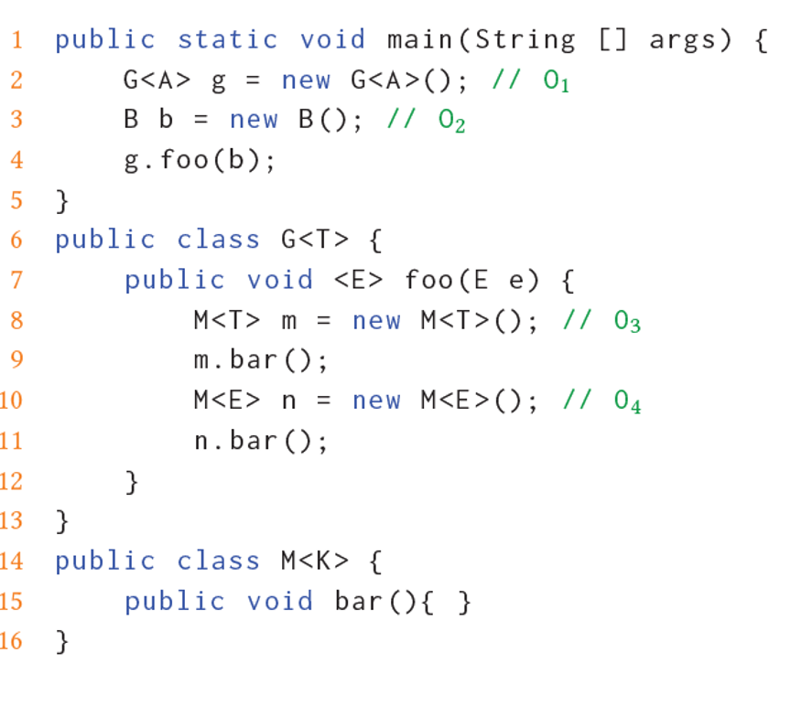
T : A
E : B
Formal Type Parameters
K : A
K : B

Slide 36
T : A
E : B
Formal Type Parameters
K : A
K : B

Slide 37

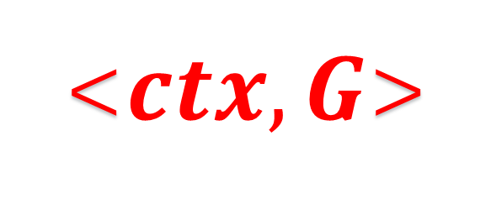
Context Customization
$$ctx$$
→
<$ctx, G$>
Τ : A
Formal Type Parameters
Instantiation Sites
/
Actual Type

Slide 38
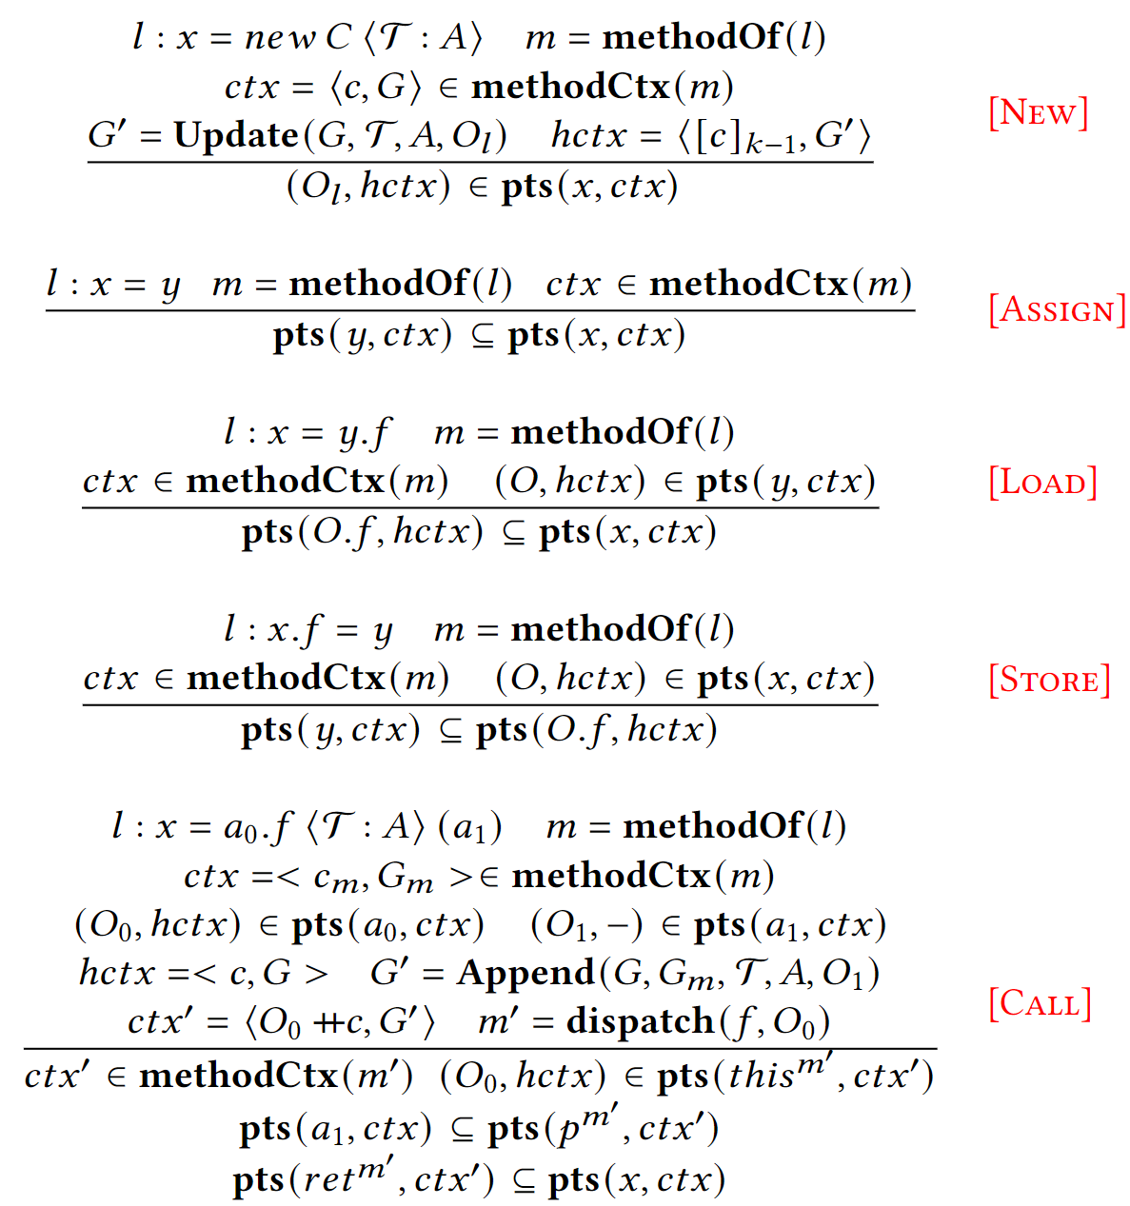
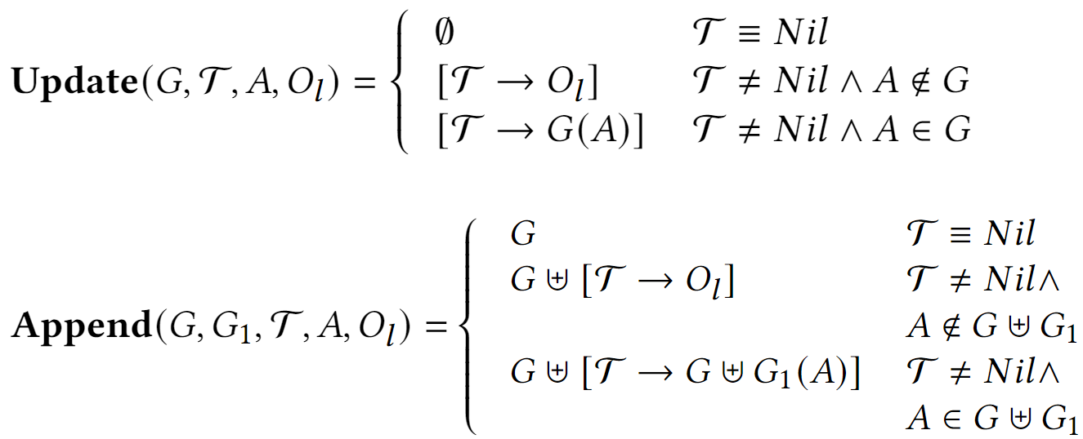
Rules for k-Obj analysis with generic customization

Slide 39
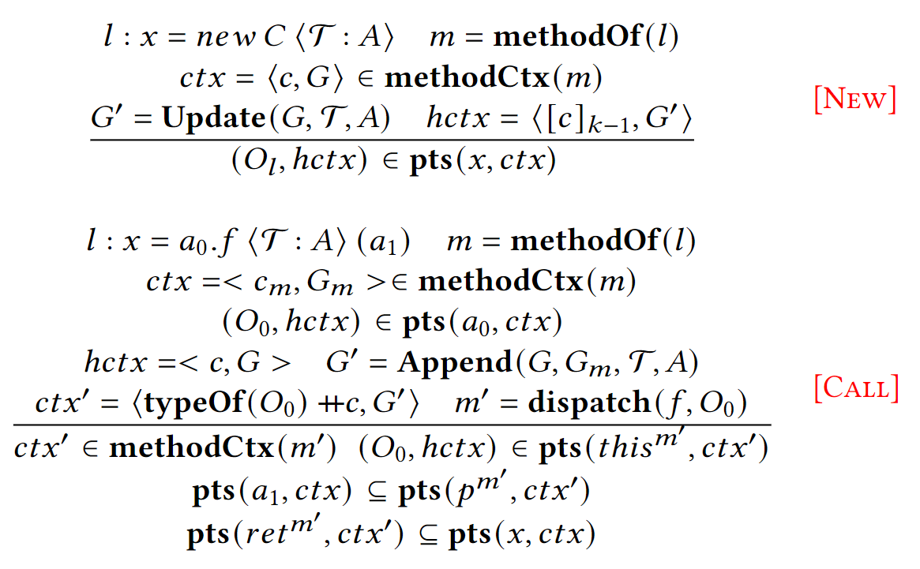
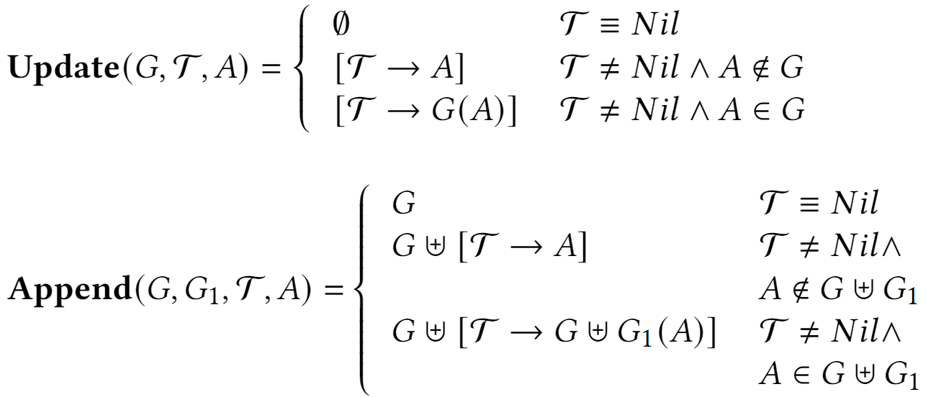
Rules for k-Type analysis with generic customization

Slide 40
Evaluation
Benchmarks: Dacapo + 7 popular open source programs
Precision metrics:
#call-edges
#poly-call
#cast-may-fail
#reach-methods

Slide 41
precision
chart
performance
Speed up 62 X

Slide 42
precision
chart
performance
Speed up 7 X

Slide 43
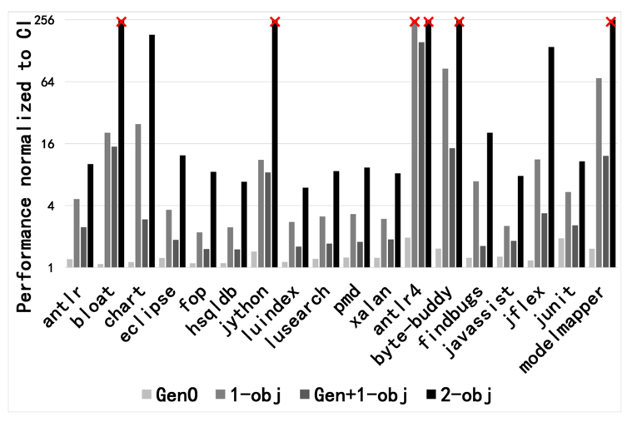
Performance of object sensitive group.

Slide 44
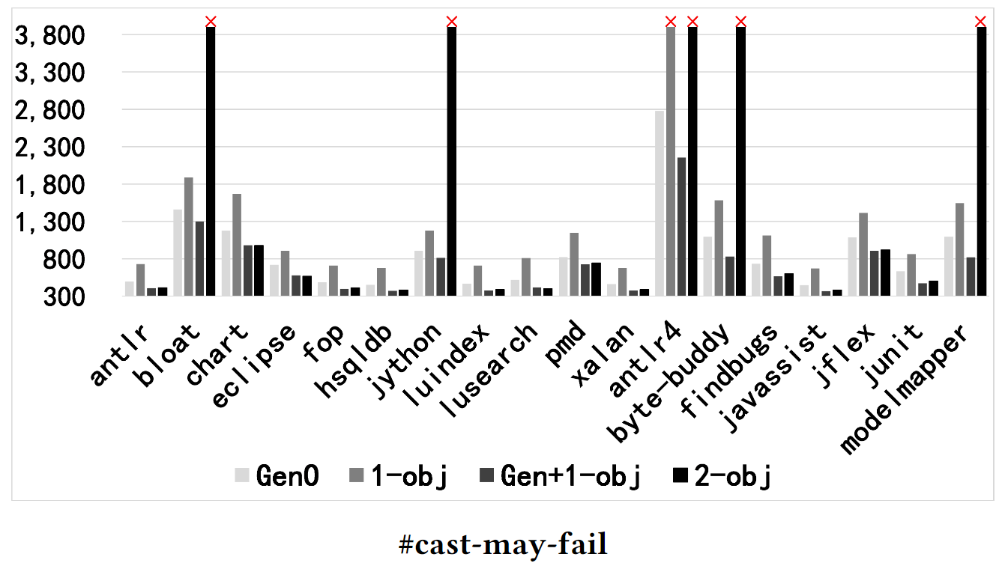
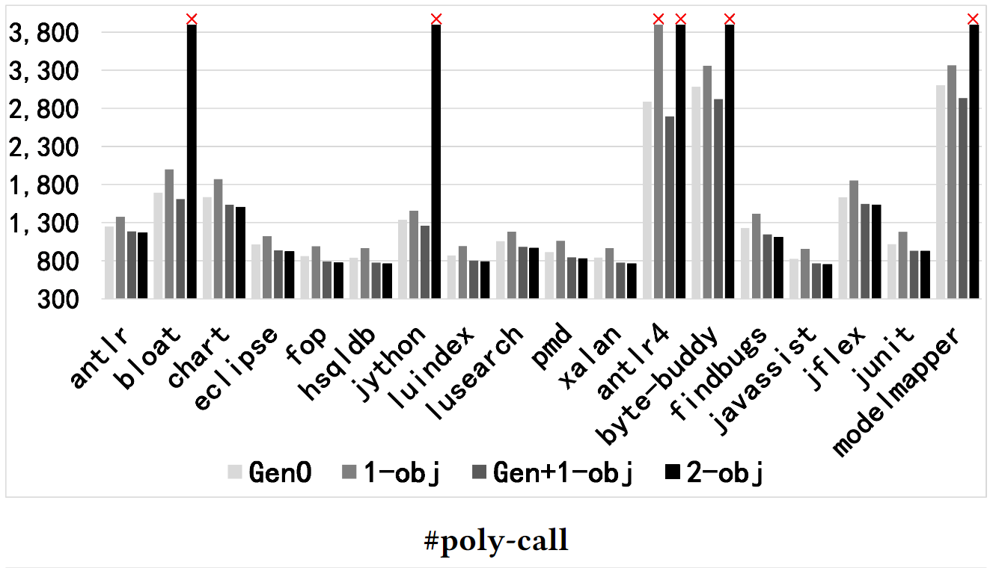
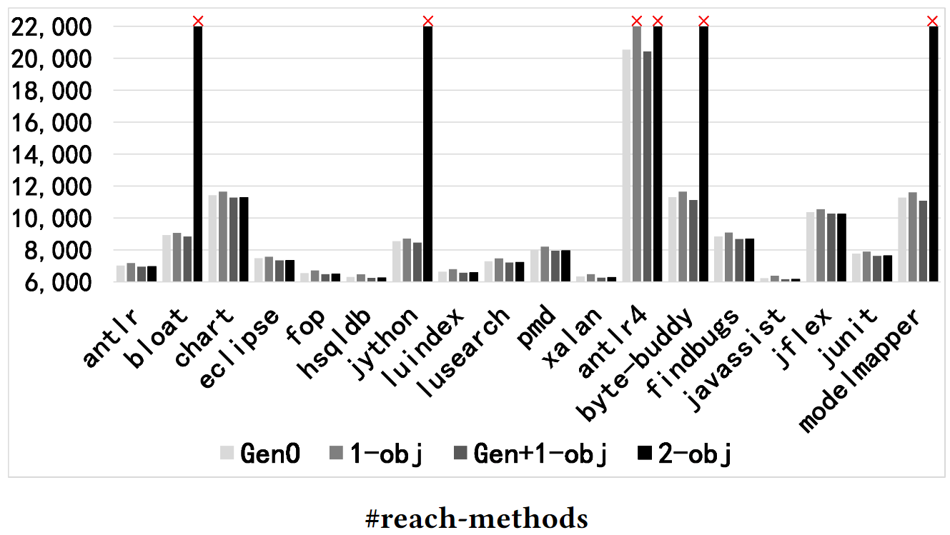
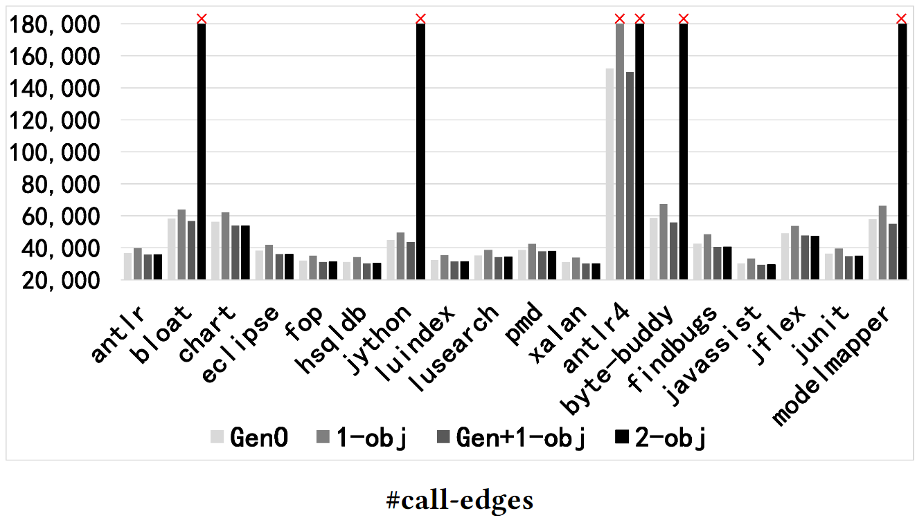
Precision metrics, the lower the better. Those timeout cases are outlined with cross.

Slide 45
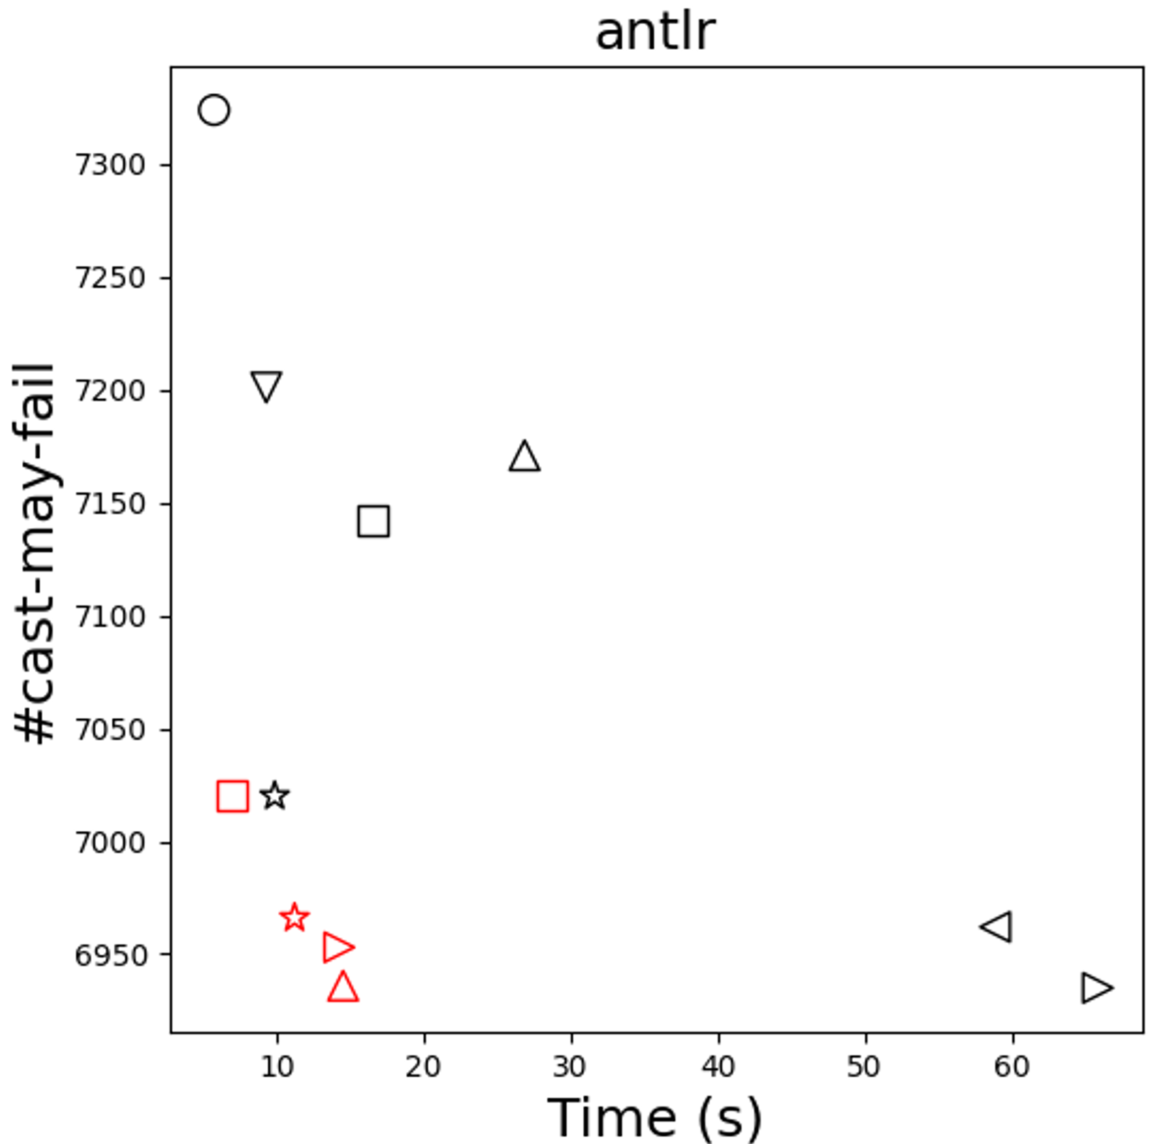

Slide 46
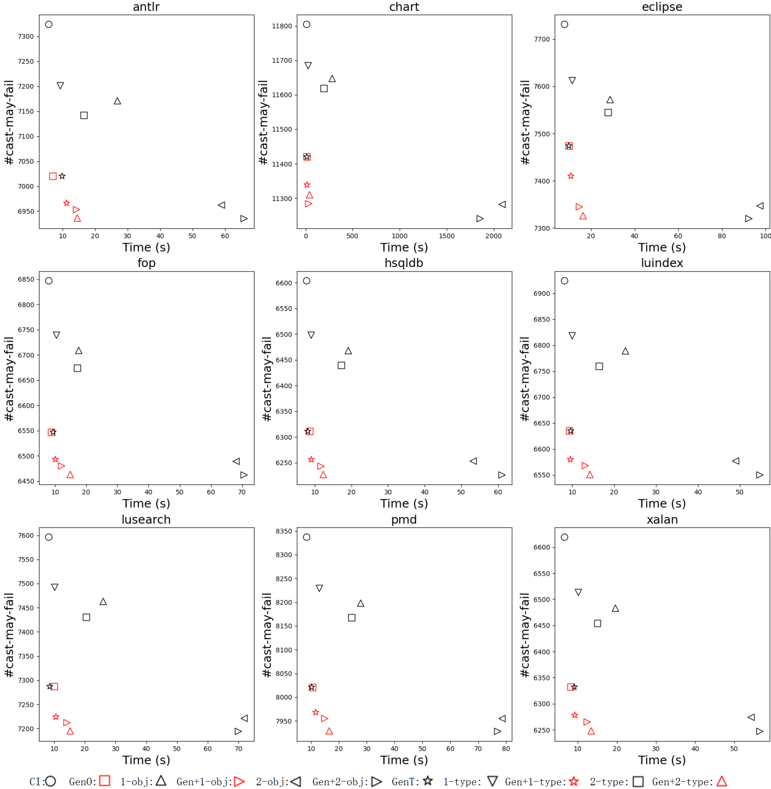

Slide 47
Conclusions
We present generics sensitivity, a new context customization scheme targeting generics.
We demonstrate how to apply our context customization scheme to two mainstream context-sensitive variants: k-object-sensitivity and k-type-sensitivity.
We implement different variants of generics sensitive pointer analysis in WALA.
We evaluate a large set of applications, generic context customization can achieve overall better precision with a significant speedup: 12.6X on average and up to 62X.

Slide 48

Thank you!

